Slide 1
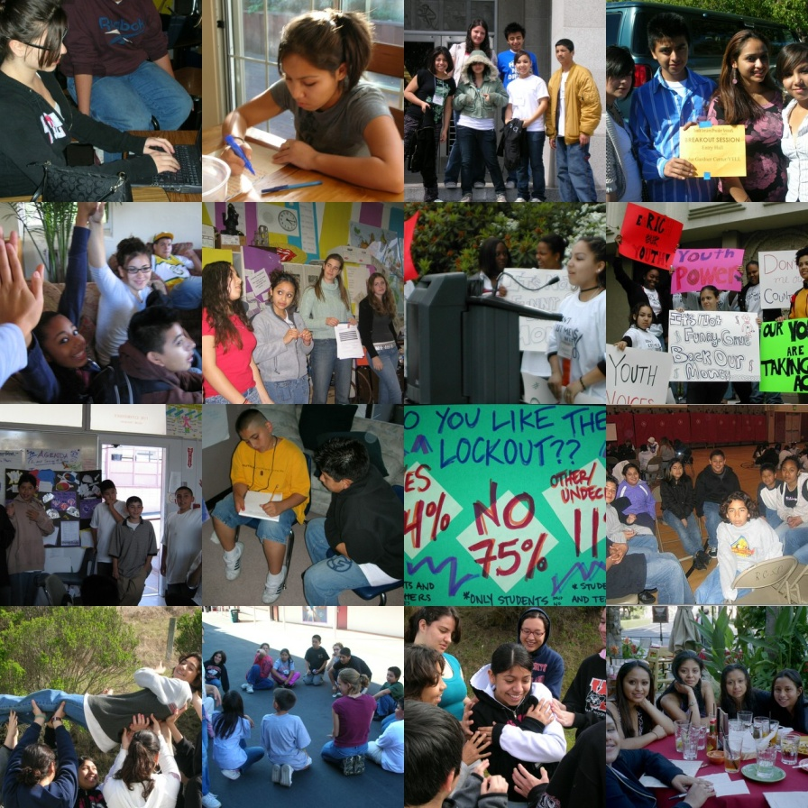
January 2012
Community Youth Development Initiative
(CYDI)
A partnership between
Redwood City 2020
and
The John W. Gardner Center for Youth and Their Communities at
Stanford University
María Fernández
mafernandez@stanford.edu
650.218.3140

Slide 2
What WE WANT TO ACCOMPLISH
Vision: A vibrant Redwood City and North Fair Oaks community that values and shares responsibility for the health and well-being of all our young people.
Long-Term Outcomes
(10 years out)
The Redwood City community works with youth as partners in improving the health and well-being of all people.
Youth have the knowledge, resources and self-confidence to pursue their passions and reach their goals.
Adults and youth develop trusting relationships and work together to improve their community.
Parents and caregivers have the knowledge, resources and self-confidence to participate in the community and improve their quality of life.
Community youth serving organizations continually improve their efforts to provide quality experiences for youth.
Mutually beneficial collaborations among organizations and institutions benefit all members of the community – from youth to seniors.
Goal: Through collaboration, promote shared responsibility across different sectors of our community for all our youth so that they grow up with the knowledge, skills, and social attributes they need for success in school, work and life.
Build relationships to work towards a shared vision and common outcomes
Create an inclusive learning community that fosters effective youth development practices
Cultivate youth and community involvement and leadership
Use data to identify needs and track progress
Foster collaboration among organizations to promote creative thinking and leverage resources

Slide 3

WHAT DO WE MEAN BY Community Youth Development?
All community members share responsibility for the success of all local youth by:
investing resources to promote positive development of young people across settings
using an asset-based approach to address issues that prevent youth from reaching their full potential
partnering with youth to enhance the quality of life for all people in our community.
Source: Redwood City CYD Partners, June 2008

Slide 4
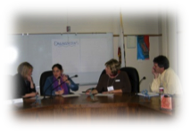
Our Organizational Partners
Acterra
Aim High
Bay Area Gardeners Foundation
Boys and Girls Clubs of the Peninsula
BUILD
Cañada College – Upward Bound TRiO Program
Casa de la Cultura Quetzalcoatl
The Center for Youth
Chicana/Latina Foundation – Youth Adelante Program
Citizen Schools
City of Redwood City
  Parks, Recreation and Community Services
  Police Department
  Public Library (including Project READ, Traveling Storytime and the Teen Center)
Cleo Eulau Center
Community Network for Youth Development
El Centro de Libertad/The Freedom Center
Fresh Lifelines for Youth
Friends for Youth
Hidden Villa
International Institute of the Bay Area
JobTrain
John W. Gardner Center for Youth and Their Communities-
Stanford University
Marine Science Institute
Mid Peninsula Housing Services Corporation
Peninsula College Fund
Peninsula Conflict Resolution Center
Peninsula Interfaith Action
Redwood City Police Activities League
Redwood City School District – School-Community Partnerships
San Mateo County Health System
  Health Policy and Planning
  San Mateo Medical Center and the Sequoia Teen Wellness Center
San Mateo County Human Services Agency
  Jobs for Youth
  Workforce Development
San Mateo County Probation Department
San Mateo County Sheriff’s Office
  Community Alliance to Revitalize Our Neighborhood (CARON)
  Sheriff’s Activities League
Sequoia Union High School District
  Migrant Education Program
  Redwood High School REAL Program
  Sequoia Afterschool for Enrichment Program (SAFE)
  Sequoia High School Dream Club
  Sequoia Teen Resource Center
Sequoia YMCA
Spark
StarVista
Teen Talk Sexuality Education
The Summit Institute
Youth Leadership Institute

Slide 5
INITIATIVE STRUCTURE
Teens in Action
Connect, highlight and integrate the work, passions and contributions of youth across our community.
Lead: John W. Gardner Center
(youth-adult partnership)
Immigrant Youth
Increase the visibility, actions of, and resources for our immigrant youth.
Leads: Sequoia Dream Club
(youth-adult partnership)
Youth Development Professional Development
Weave resources together to support adults working with youth.
Lead: Community Network for Youth Development
(adult staff participate)
OYE Ad-Hoc
Committee
Promote the integration and educational, social and cultural success of youth from Redwood City and North Fair Oaks as a way of strengthening our community as a whole.
Youth Agenda (new)
(City youth-serving departments – Library, Police, and Parks, Recreation and Community Services – providing programs and services that educate, empower, and enrich the youth of our community.
Actions Teams
(Involve approximately 12 unduplicated partner organizations and youth)
CYDI-Sponsored Professional Development
(partner organizations participate in trainings, webinars and workshops based on need and interest)
All CYDI Partners Organizations
Implement actions within their organizations that advance shared CYDI outcomes
Participate in annual partner convenings
Stay informed on key youth development issues through our monthly CYDI newsletter
Collect and provide pertinent data to track progress
Lead Partners
Initiative Lead: María Fernández, (John W. Gardner Center / Redwood City 2020 Executive Director: Patricia Brown
Oversight and Accountability
RWC 2020 Cabinet: CEOs of Core Partner Agencies Coordinating Council: Elected/Appointed Policy Makers of Partner Agencies
Provide oversight and accountability to all RWC 2020 Initiatives

Slide 6
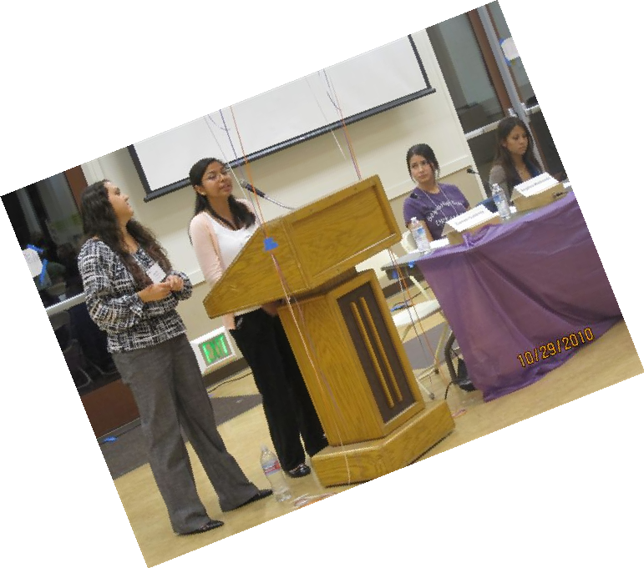
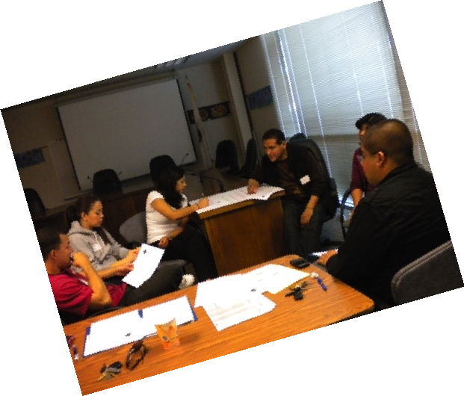
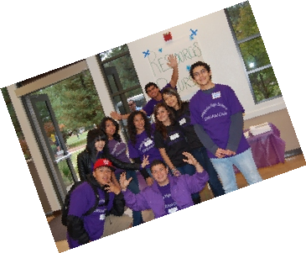
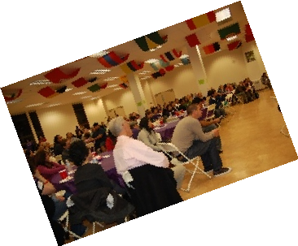
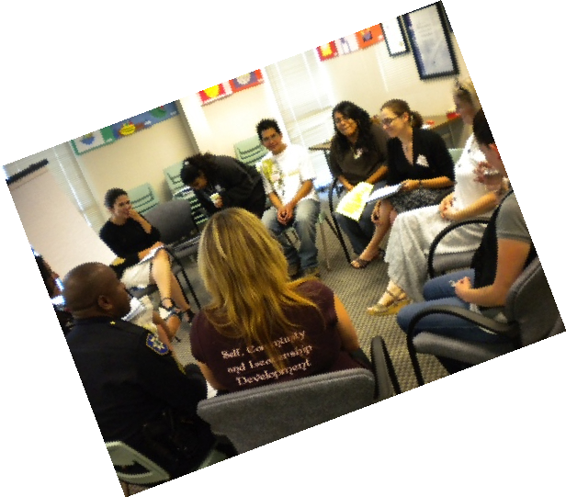
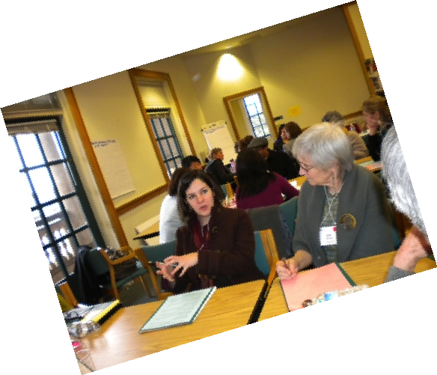
KEY HIGHLIGHTS
Meaningful Youth-Adult Partnerships
Supported Youth Workers
Growing Community Leadership
Partner organizations are leading action teams and events
Youth and adults are working together in action teams and through the Redwood City Prevention Partnership Initiative
Organizational staff are receiving quality training and professional support to improve their programs

Slide 7
TO LEARN MORE
Please visit
Redwood City 2020
www.rwc2020.org
or
The John W. Gardner Center for Youth and Their Communities
http://gardnercenter.stanford.edu

